Slide 1


Dynamic Price Incentive for EV Decarbonization Management in Distribution Network
Hongrong Yang, Dongbing Han
TRANSCENDING DISCIPLINES, TRANSFORMING LIVES
Notes:
Maximum five minutes for each group & two minutes for Q&A
Around five slides
Course provided topics
Focus on your implementations and preliminary results
Any challenges/difficulties so far?
Self-defined topics
Focus on topic motivation & introduction
Hello

Slide 2
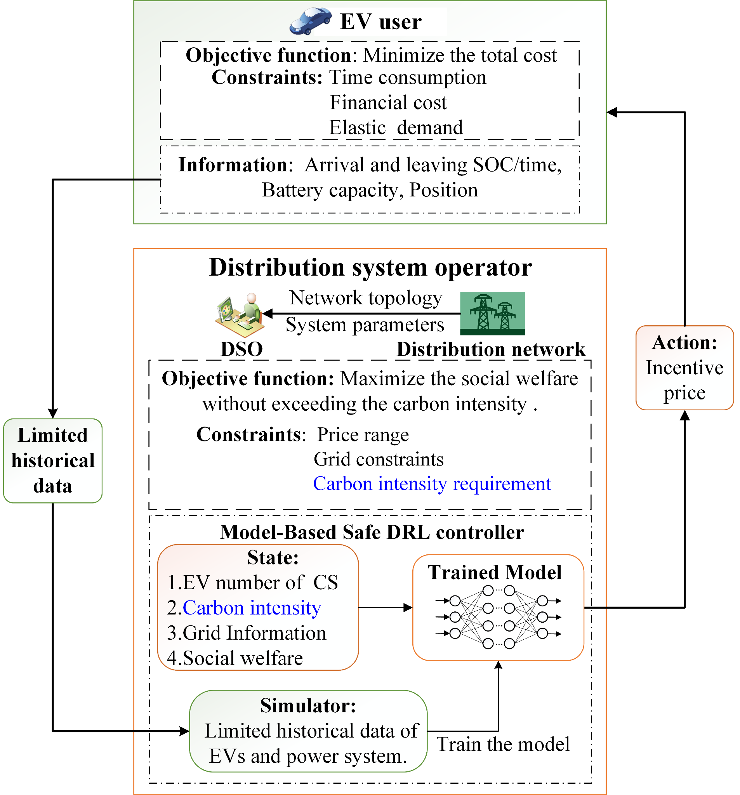
Carbon Intensity
Purpose:
Optimize EV charging price incentives to balance social welfare, grid safety (e.g., congestion management), and carbon emission.
Method:
Original Framework:
Formulated the congestion management problem as a Constrained Markov Decision Process (CMDP).
State variables include EV distribution at charging stations, Grid information and Social welfare
Extended Framework (with Carbon Constraints):
New state information: System carbon intensity.
New cost terms: penalties for exceeding carbon intensity limits
Verification Method:
Simulation with a modified IEEE 33-bus distribution system coupled with a real-world transportation network.
‹#› |
Notes:
Hi everyone,
Today, my teammate Hongrong and I are excited to share our project.
Our work focuses on maximizing social welfare while also controlling carbon emissions in Electric Vehicle charging.
We build on a previous project that designed a price incentives strategy to manage real-time congestion in distribution networks.
In our project, we add two new ideas:
First, we track the system-wide carbon intensity.
Second, we introduce a penalty when the carbon limit is exceeded.
To start, I’ll hand it over to Hongrong to explain how we measure carbon intensity.

Slide 3
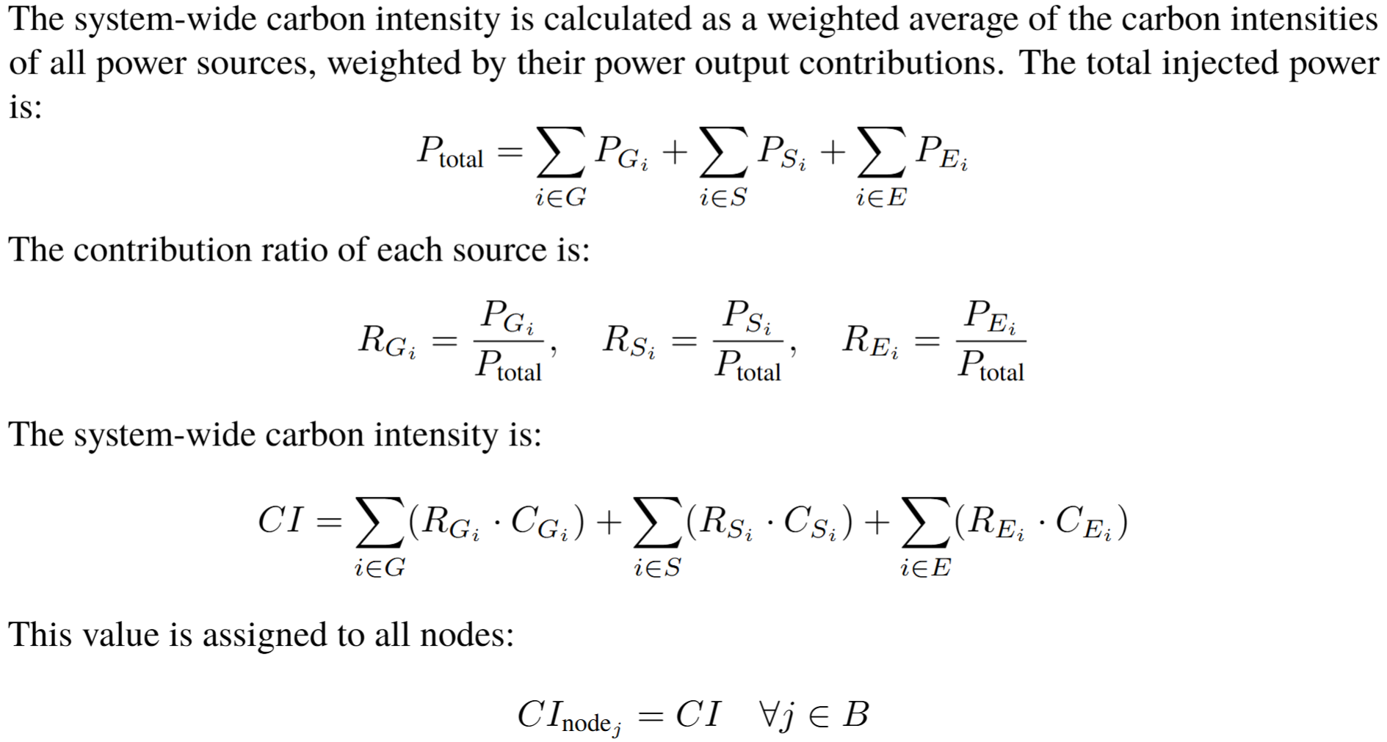
Carbon Intensity
‹#› |
Notes:
The carbon intensity of the whole distribution network is calculated as a weighted average of the carbon intensities of all power sources, weighted by their power output contributions, that is, the proportion of power sources multiply their carbon intensity, the power sources include the local generator, the renewable generator and the external energy from the main grid, usually, renewable energy has the lowest energy carbon intensity. So from the definition of system carbon intensity, if we assume the distribution network is isolated do not consider the grid topology, the carbon intensity of the system is independent of the loads in the network, and electric vehicles cannot affect it.

Slide 4
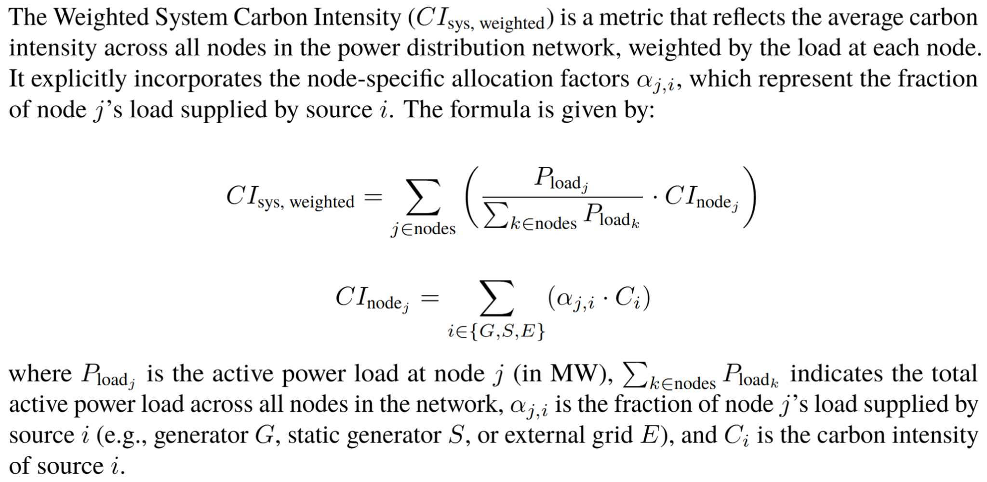
Carbon Intensity
‹#› |
Notes:
n practice, we calculate system carbon intensity using a weighted approach, accounting for the varying energy contributions of different generators at each node. Consequently, when electric vehicle (EV) distribution is altered through price incentives, the overall system carbon intensity changes accordingly.​

Slide 5
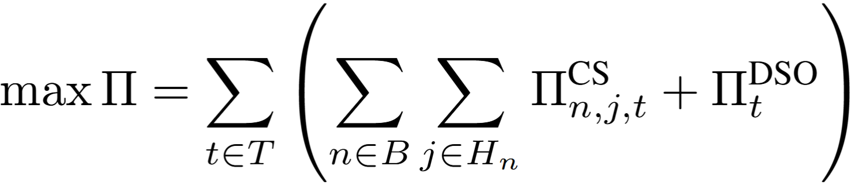
Framework
DSO changes the EV distribution through the charging price, and the relocated EVs will impact the system carbon intensity since the nodes have different fraction of node’s power supplied by different generators.
The EV user aims to minimize the total charging cost: The DSO aims to maximize the social welfare without exceeding the carbon target under the grid constraints:
The optimization variables (actions) are the incentive price of three charging stations set by DSO.
‹#› |

Slide 6
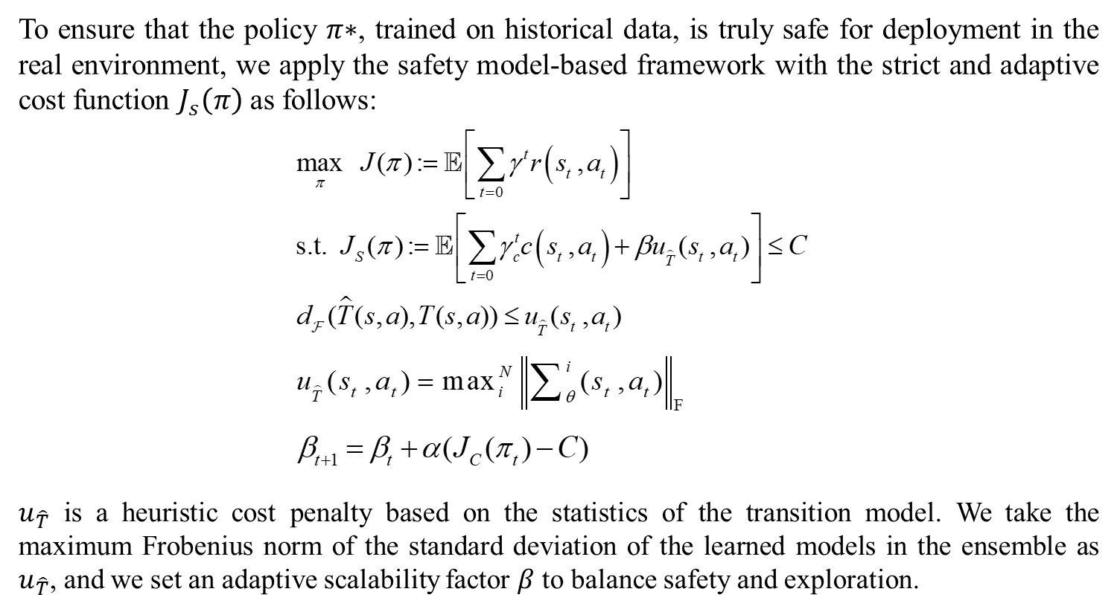
Methodology
‹#› |
Notes:
The core idea is to establish an upper bound on the model error and incorporate it into the optimization process through a heuristic cost penalty term. To enhance the algorithm's flexibility, we introduce an adaptive scaling factor that dynamically adjusts the penalty's weight based on the system's behavior.

Slide 7
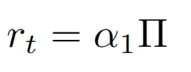
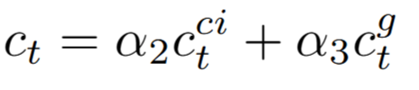
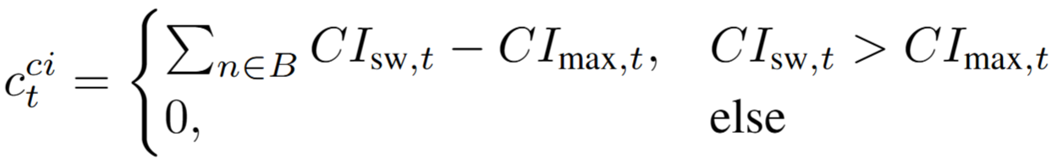
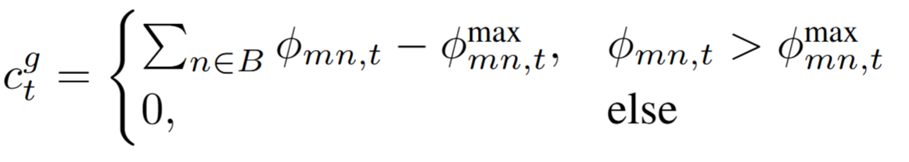
Methodology
State: Charging EV number, grid information, system carbon intensity, social welfare.
Action: The incentive charging price of three charging stations.
Reward: The scaled social welfare. Cost: The scaled cost for carbon target violation and line congestion.
‹#› |

Slide 8
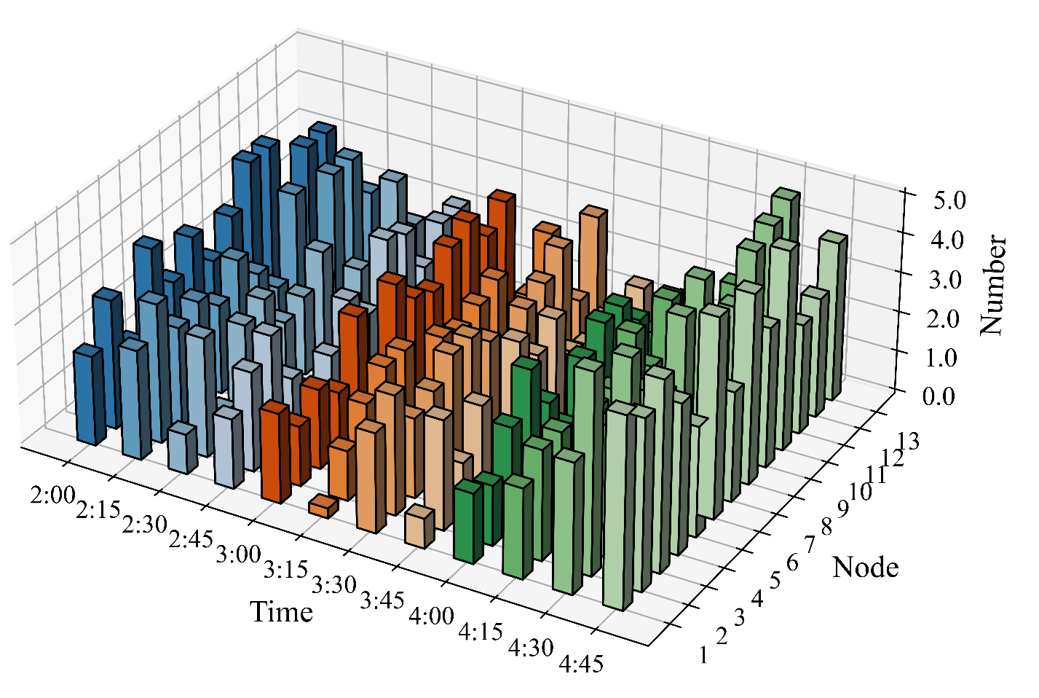
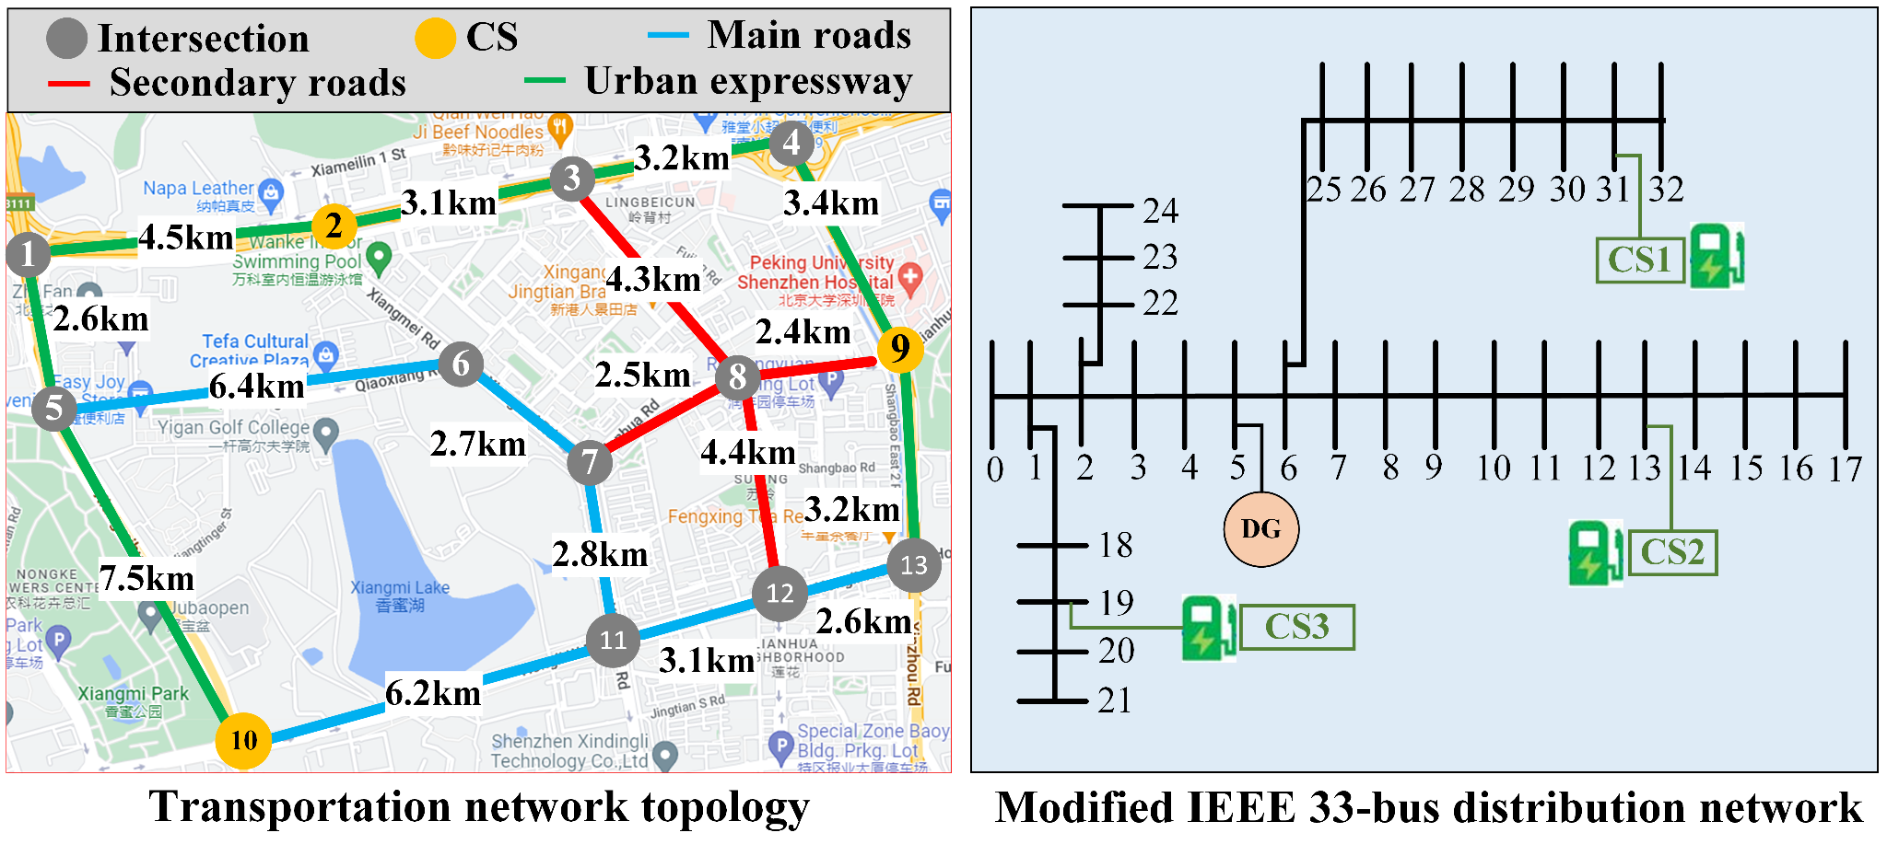
Simulation setting
Number of EVs with charging demand at each traffic node.
‹#› |
Notes:
Welcome back to our case study section.
This slide shows the setup of our simulation environment. It combines three parts: the power distribution network, the transportation network, and Electric Vehicle charging demand.
We use a real map from Shenzhen, China, for the transportation network. We set up three charging stations at different locations, marked in yellow — at nodes 2, 9, and 10.
For the power system, we use a modified version of the classic IEEE 33-bus distribution network. The charging stations — CS1, CS2, and CS3 — are connected to different buses. There is also a distributed energy source located at node 18.
Finally, the last figure shows how Electric Vehicle charging demand changes across space and time.

Slide 9
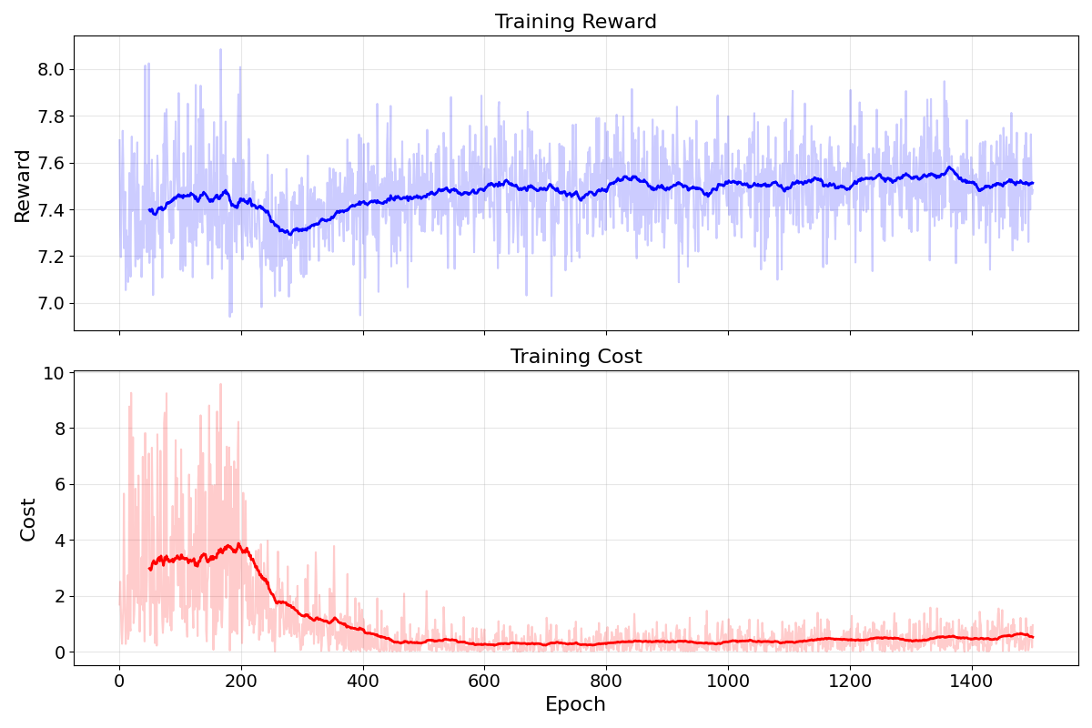
Results
‹#› |
Notes:
We can see after about 300 epochs, the reward curve becomes stable and starts to rise. This means the model has found a better strategy. I
n the chart, the dark line shows the average reward or cost every 50 steps. The light line shows the actual values at each step.
The cost includes both carbon constraint violations and grid congestion violations across the whole system.
In the early stage, especially between 100 and 200 epochs, the cost is quite high. This shows that the system often broke carbon or grid limits. After around 200 epochs, the cost drops significantly. This indicates that the model is progressively learning to avoid violating the carbon and grid constraints.

Slide 10
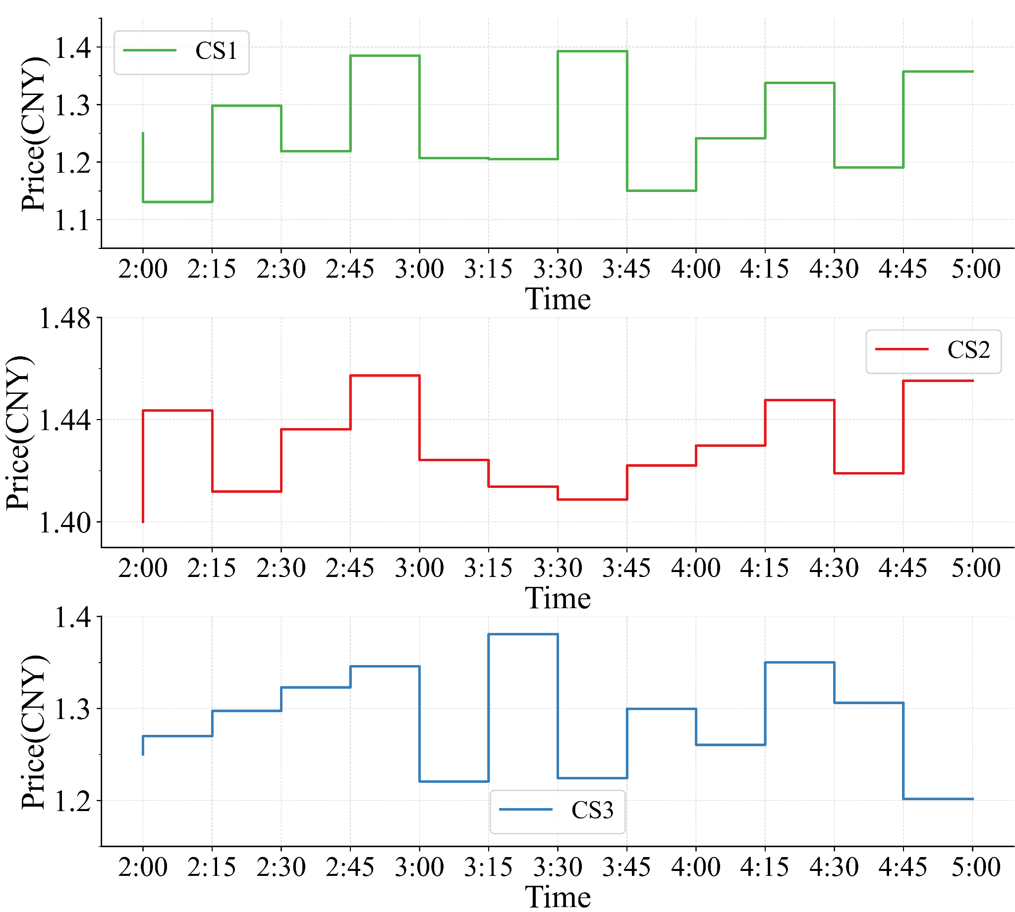
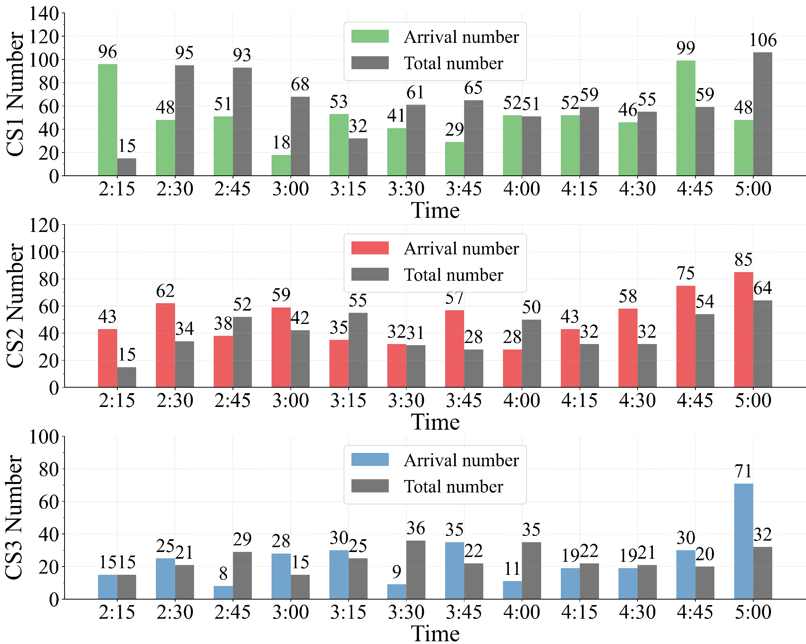

Results
‹#› |
Notes:
The next slides shows:
On the left, we see the price curves for the three charging stations — CS1, CS2, and CS3.
On the right, we see the Arrival Number and Total Number of Electric Vehicles at each station.
It is clear, for CS3, the arrival number was usually the lowest. But between 4:45 and 5:00 PM, there was a sudden jump. This happened because CS3 dropped its price a lot at the end of day. So more Electric Vehicles moved to CS3, showing that the price incentives worked well.

Slide 11
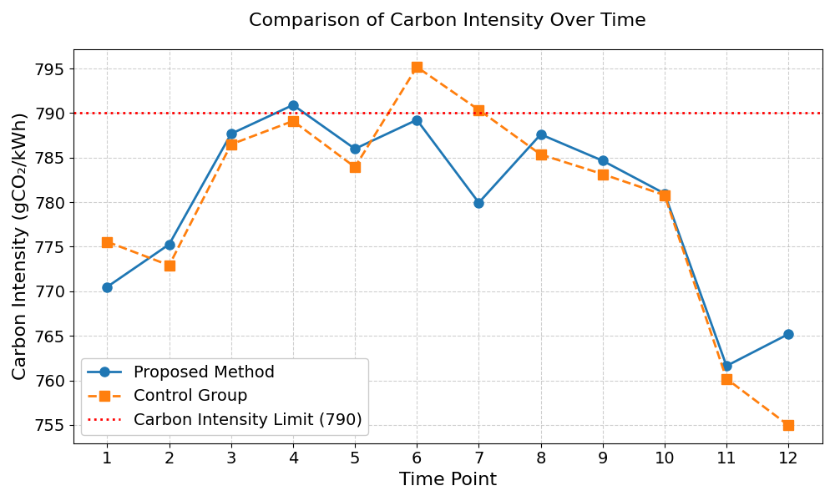
Results
‹#› |
Notes:
The final chart shows carbon intensity over time with our proposed approach and carbon intensity limits at 790 gCO₂/kWh.
It is clear without carbon constraints, the control group occasionally exceeded the carbon limit.
In contrast, the proposed method effectively kept the system-wide carbon intensity below the target most of the time.
That’s all our project, thanks so much !

Slide 12

Thank you
‹#› |
Notes:
‹#›

